Slide 1

EMPLOYEE IDENTITY GRAPH

Slide 2
Employee as the most valuable assets for contemporary organizations go through cycles of career development and advancement; engage with variety of HCM applications. There isn't a connection between different employers, different applications to stitch them together.
Identity graph, along with identify resolution, creates a single unified identifier for workers and organizes every facets of employee profile into a consistent, clean and connected data unit.

Slide 3

we are developing a model which uses client and employee details, and produces the data which would help us to know following outcomes:
An employee's journey map
For which client, a client is losing its employees to.

Slide 4
This project is scalable, it can answer to various questions like
Which location is being preferred by most of the employees.
what is the minimum duration that employees are preferring to work with a client and many more...

Slide 5
We work with following:
AWS S3 bucket
AWS IAM role
AWS VPC endpoints
AWS Sage Maker
AWS Neptune
Databricks
SQL
Gremlin

Slide 6
GRAPH DATABASE
a graph database is a database that uses graph structures for semantic queries with nodes, edges and properties to represent and store data
graph DB are optimized to store and query the relationship between data and data items
data items - vertices (nodes)
relationships between data items- edges(predicates)
each edge has a type
when data deals with the connections and relations, it is best to use graph databases.
In relational DB, more joins, more multiple foreign keys, need to write nested SQL queries and complex joins- performance degraded quickly as the amount of data increases.
graphs can represent the inter relationships of real- world entities in many ways, in terms of action, ownership, parent age, purchase, choices, personal connections, family ties etc,.

Slide 7
Areas where graph databases are used
Knowledge Graphs
Identity Graphs:- used for personalising interactions with users ex: product recommendations and friend recommendations.
Fraud Graphs
Social Networking
Driving Positions(best routes)
Logistics- graphs can help identity the most efficient way to use available shopping and distribution resorces to meet customer requirements
Diagnostics - to identify the source of observed problems and failures
Scientific Research
Regulatory Rules - you can store complex regulatory requirements as graphs, and query them to detect situations where they might apply to your day to day business operations
Network topologies and events

Slide 8
Amazon Neptune
Neptune is a graph data base service; it can store and manage billions of relationships and offer query access at millisecond latency.
It is built on a cluster base model.
Cluster has set of Instances
graphs represent complex, interconnected information as well as the relationships within it in a clear way, and they store this data as a large, coherent data set.
Edges have a start and end point, while each node always has a certain number of relationships to other nodes, whether incomming, outgoing or undireced.
Established concepts for constructing such graph db's are the labeled property graph and the resource description framework (RDF): with the former, certain properties are assigned to both the nodes and edges.
One of the strengths of the database is that the relationships are strong in databse itself, so they don't need to be calculated in the query.

Slide 9
Strength of a database can be measured using four principal factors
Integrity
Performance
Efficiency
Scalability

Slide 10
Graph DB model is particularly agile, because complexity and the quantity of the data don't negatively influence the query process in this model.
Graph DB's are not a complete solution, they are LIMITED, for ex-, Where SCALABILITY is concerned. As they are principally designed for one-tier architecture, growth represents a (mathemtical) Challenge.
There is still no uniform Query Language.

Slide 11
WHY NEPTUNE?
It is a cloud Technology based Amazon Database
It supports AWS
It has fault tolerance, fast and reliable database.
It handles, operates, and modify graph DB in the application. About Neptune:
It doesn't support secondary index (unique value is created for each record in data file which is a candidate key (non clustering index)(dense index))
It doesn't support triggers and serve side script.
It is used for graph DB management systems.
It is released in 2017.
It supports schema free data or information
It uses foreign key for Inter connection.
It is hosted by Amazon.
It supports RDF 1.1 / SPARQL 1.1 and Tinker Pop Gremlin 3.3, java PHP , PHP, JS, Python, Ruby and scala.
It is supported by ACID Compliant

Slide 12
Neptune QUERY Languages
Gremlin
Open Cypher
SPARQL

Slide 13
GREMLIN:
graph traversal language
created by Apache Tinker pop
works by using virtual machines in backend
it is an imperative syntax that lets you control how you move through your graph in a series of steps, each of which takes in a stream of data, performs some action on it and outputs the results to the next steps
Advantages:
easy to use
proper documentation is given by tinkerpop
gremlin is compatible with both OLAP and OLTP engines (there are very few graph traversal databases that are compatible with both engines )
Disadvantages:
very hard to learn
has very complex visualization setup
has very buggy visualization they don't work properly

Slide 14
OPEN CYPHER:
It provides a familiar structure to compose queries for graph applications.
Declarative query language for property graphs.
it uses declarative syntax, inspired by SQL that specifies pattern of nodes and relationships to find your graph.
mainly used for key value pair
performs tasks such as matching insertion, update, deletion of key value pair
Limitations:
only available for the queries that perform read only operations
queries that perform any sort of mutation, such as CREATE, DELETE, MERGE, SET and so on are not supported
operations and output for a specific plan may change in future
for dat aloaded as RDF, then open cypher can't be used

Slide 15
SPARQL:
Amazon Neptune has added a SPARQL feature named explain. This feature is a self-service tool for understanding the execution approach taken by the Neptune engine.
Neptune currently supports explain only in SPARQL SELECT queries.
Limitations:
you can transfer other query forms such as ASK, CONSTRUCT, DESCRIBE and SPARQL UPDATE queries into SELECT queries. Then we can explain to inspect the corresponding SELECT query instead.
Explain Operators May Change in Future Releases
Explain Output May Change in Future Releases

Slide 16
MAJOR MILESTONES IN PROJECT:
LOADING THE DATA INTO S3
LOADING THE DATA INTO NEPTUNE
QUERYING IN NEPTUNE DB
CREATING JOURNEY MAP OF AN EMPLOYEE
VISUALISING AND FINDING OF: FOR WHICH CLIENTS, A CLIENT IS LOSING THEIR EMPLOYEES TO

Slide 17
CREATION OF AN S3 BUCKET https://docs.aws.amazon.com/quickstarts/latest/s3backup/step-1-create-bucket.html
CREATION OF AN IAM ROLE https://docs.aws.amazon.com/IAM/latest/UserGuide/id_roles_create_for-user.html
CREATION OF A NEPTUNE DB https://docs.aws.amazon.com/neptune/latest/userguide/get-started-create-cluster.html
LOADING DATA INTO NEPTUNE https://docs.aws.amazon.com/neptune/latest/userguide/get-started-loading.html
Gremlin load data format - Amazon Neptune https://docs.aws.amazon.com/neptune/latest/userguide/bulk-load-tutorial-format-gremlin.html
Example: Loading Data into a Neptune DB Instance - Amazon Neptune https://docs.aws.amazon.com/neptune/latest/userguide/bulk-load-data.html

Slide 18
S3 BUCKET USED : s3://datacloud-datascience-dxr-staging-blue-708035784431tf/graph-db-poc/
IAM ROLE USED: arn:aws:iam::708035784431:role/demo-neptune-load-role
NEPTUNE USED: https://us-east-1.console.aws.amazon.com/neptune/home?region=us-east-1#database:id=database-demo-1;is-cluster=true;tab=connectivity
SAGEMAKER NOTEBOOK INSTANCE USED: https://us-east-1.console.aws.amazon.com/sagemaker/home?region=us-east-1#/notebook-instances/adp-ds-sharmar

Slide 19
LOADING THE DATA INTO S3

Slide 20
the data source which we are using is
us_east_1_fit_ds_live_main.employee_main_monthly

Slide 21
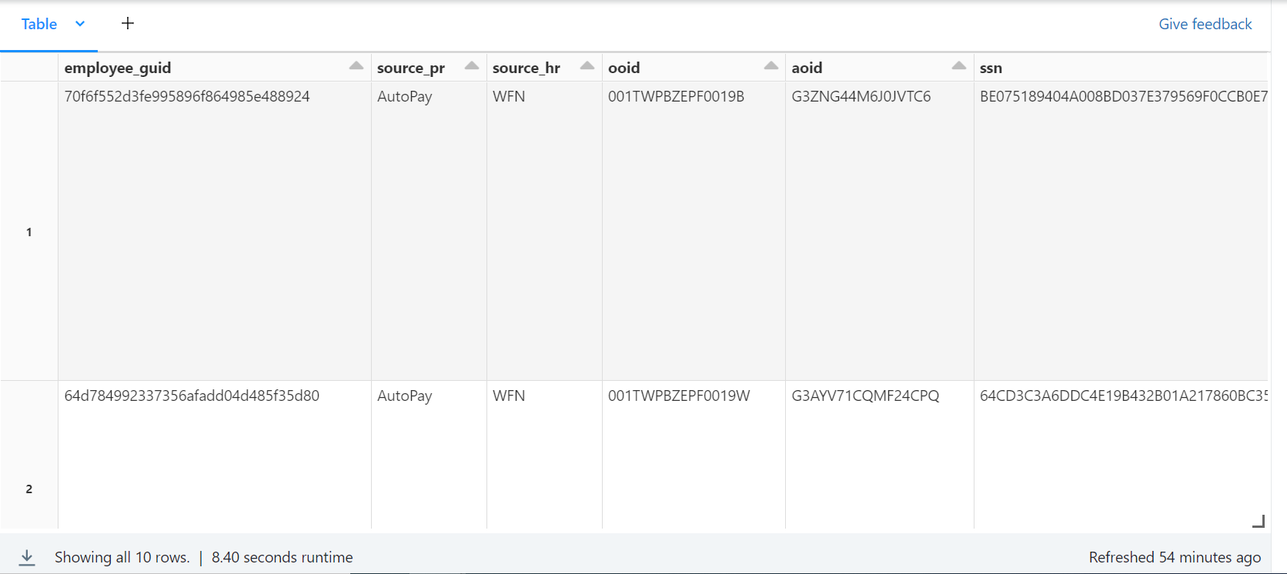
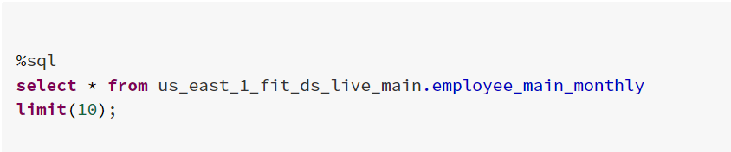

Slide 22
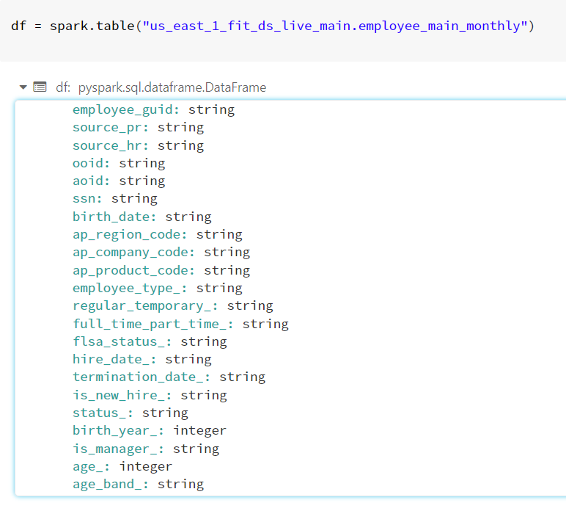
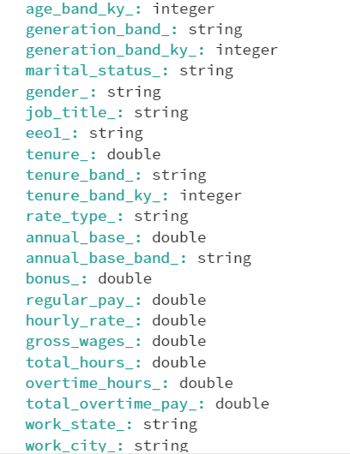
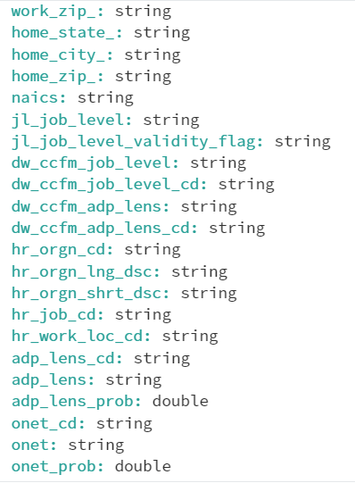
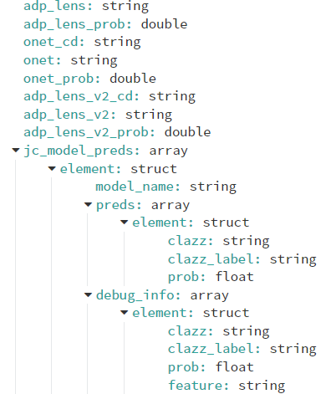
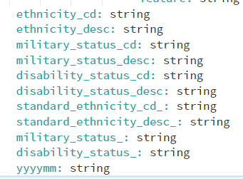

Slide 23
the data that Amazon Neptune accepts should be in csv format
two files needed for the model
one is vertices file and other is edge file
vertices and edges should be stored in different files
loader can load multiple vertex and edge files in a single load job
file name and file extensions are not important
Amazon Neptune CSV format follows: RFC 4180 CSV Specification
each file has a comma-separated header row, the header row consists of both systems columns' headers and property column headers'
Required and allowed system column headers are different for vertex and edge files
labels are case sensitive

Slide 24
VERTEX HEADERS
~id (for vertices)
~label (separated by ;)
every vertex must have at least one label, if we don't provide label, tinker pop supplies a label

Slide 25

EDGES HEADERS
~id (for edge)
~from (From vertex id)
~to (to vertex id )
~label
edges cab have only single label, if we don't provide label, tinker pop supplies a label

Slide 26
PROPERTY COLUMN HEADERS
you can specify a column for a property by using below syntax Propertyname:type (not case sensitive) or propertyname:type[] (property names cannot include spaces)
edge properties can only have a single value and will cause an error if an array type is specified, or a second value is specified ex- age:int
arrays of strings are allowed, but strings in an array cannot include the ;, character, unless it is escaped using a backlash(;)

Slide 27
Creation of table datacloud_nonprod_dit_raw.complete_table1
the records that are included are of
persons who have worked with more than one client
which doesn't have any null or empty values,
all the records are grouped by ssn and ooid, and included all the months of records of a particular person as the (min and max month) as the duration

Slide 28
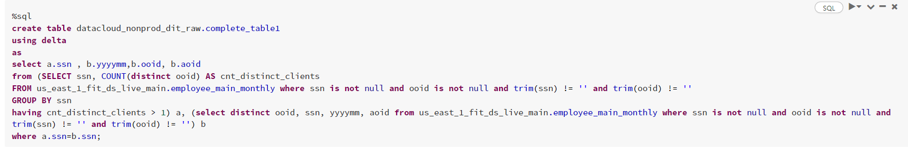

Slide 29
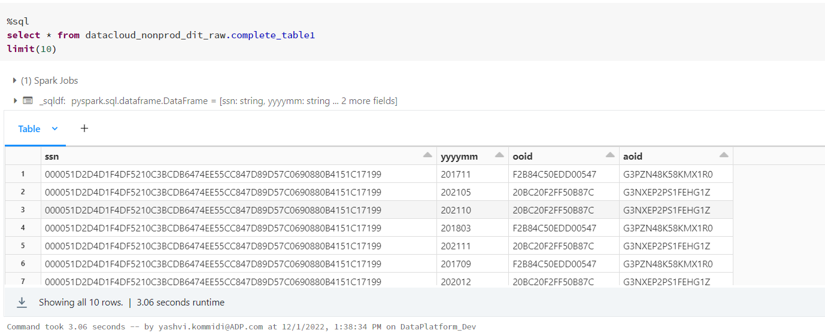

Slide 30
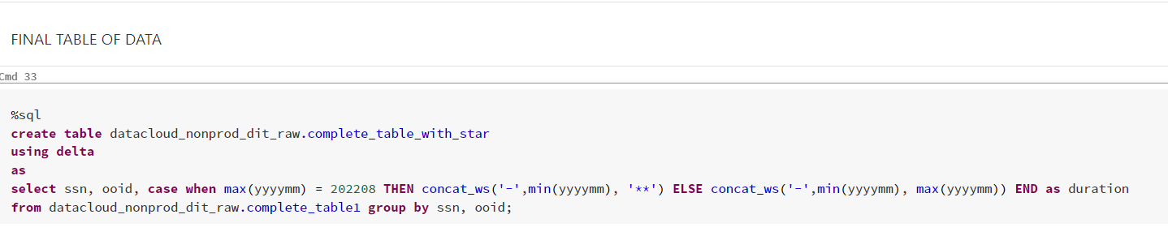

Slide 31
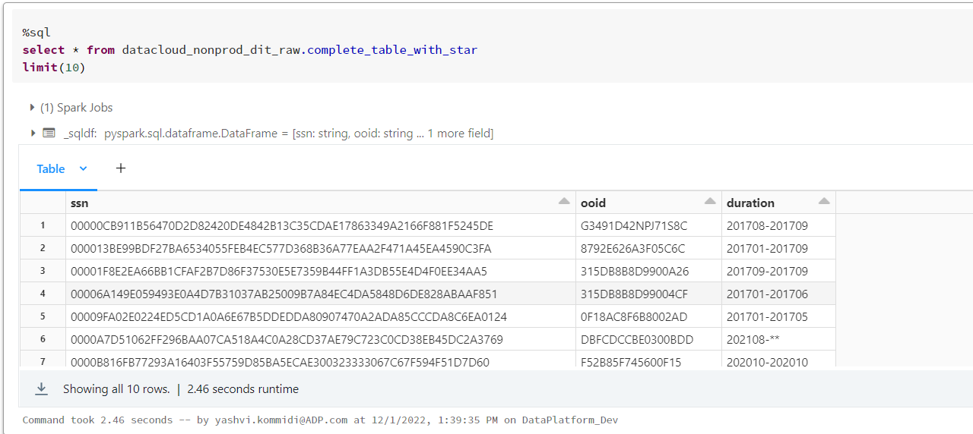

Slide 32
for vertices file
~id as ssn and ooid
~label as person for ssn and client for ooid

Slide 33
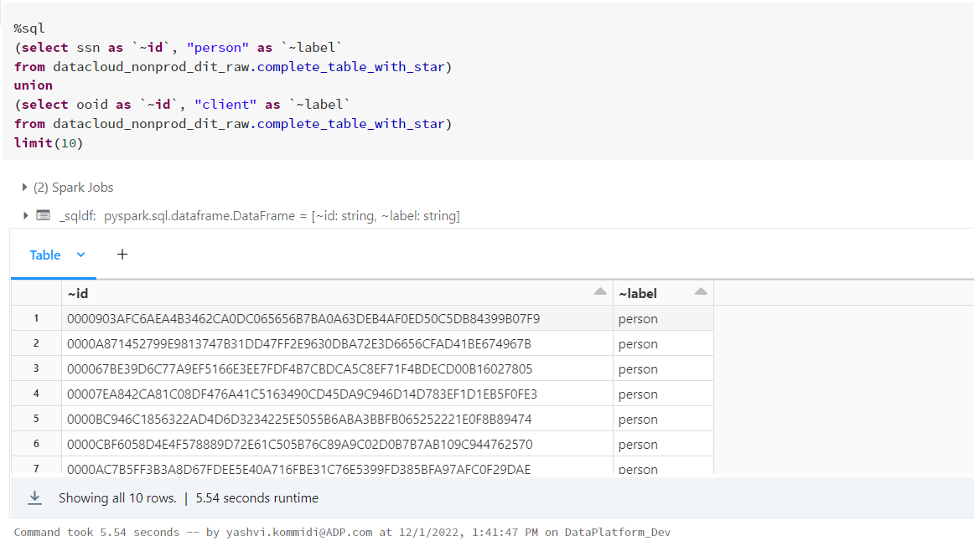

Slide 34
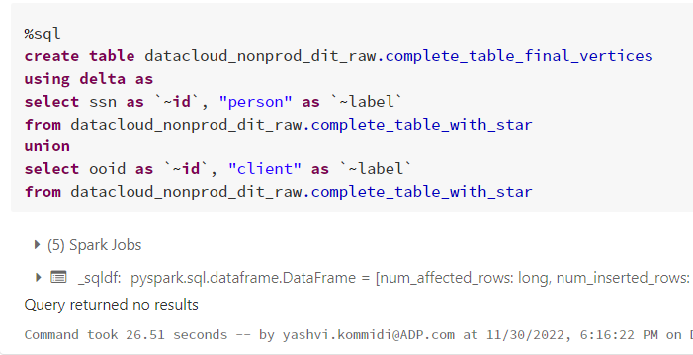

Slide 35
for edges file
first edge file has
~id as uuid()
~from as ssn
~to as ooid
~label as duration
second edge file has
~id as uuid()
~from as ooid
~to as ssn
~label as duration

Slide 36
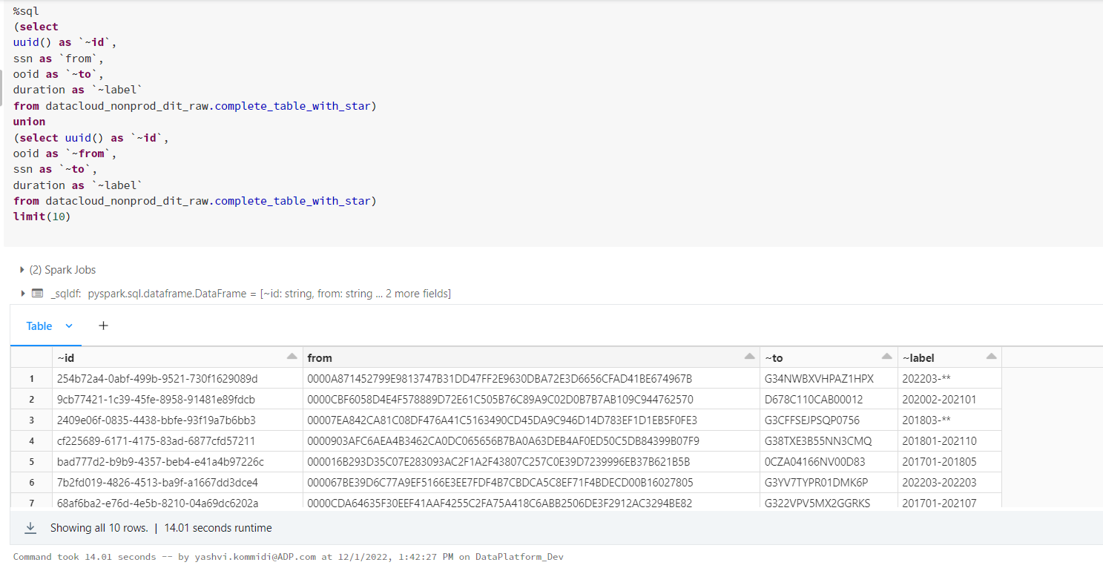

Slide 37
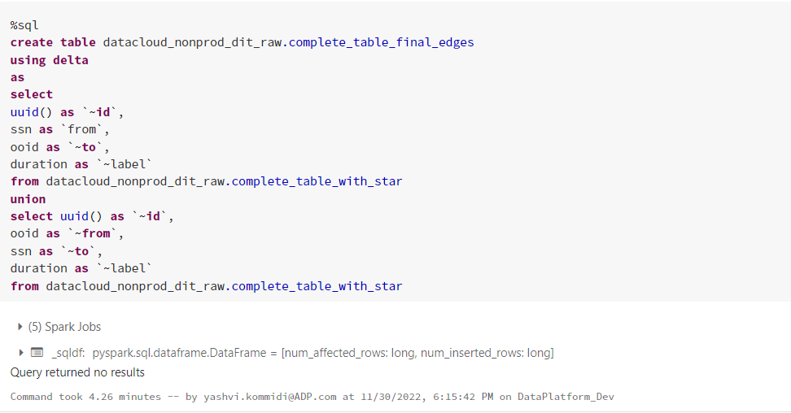

Slide 38
FINAL VERTICES TABLE ---- datacloud_nonprod_dit_raw.complete_table_final_vertices

Slide 39
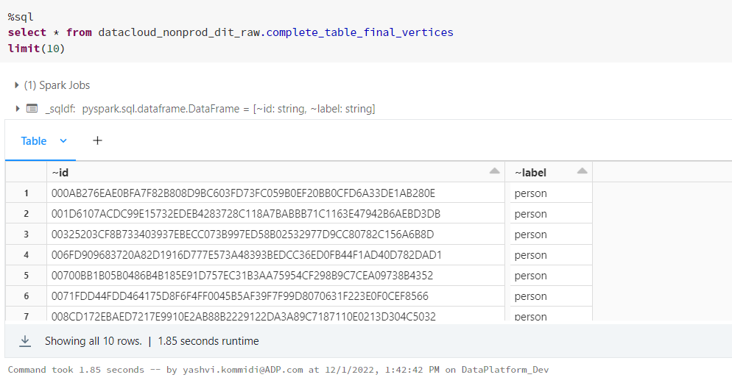

Slide 40
FIANL EDGE TABLE ---- datacloud_nonprod_dit_raw.complete_table_final_edges

Slide 41
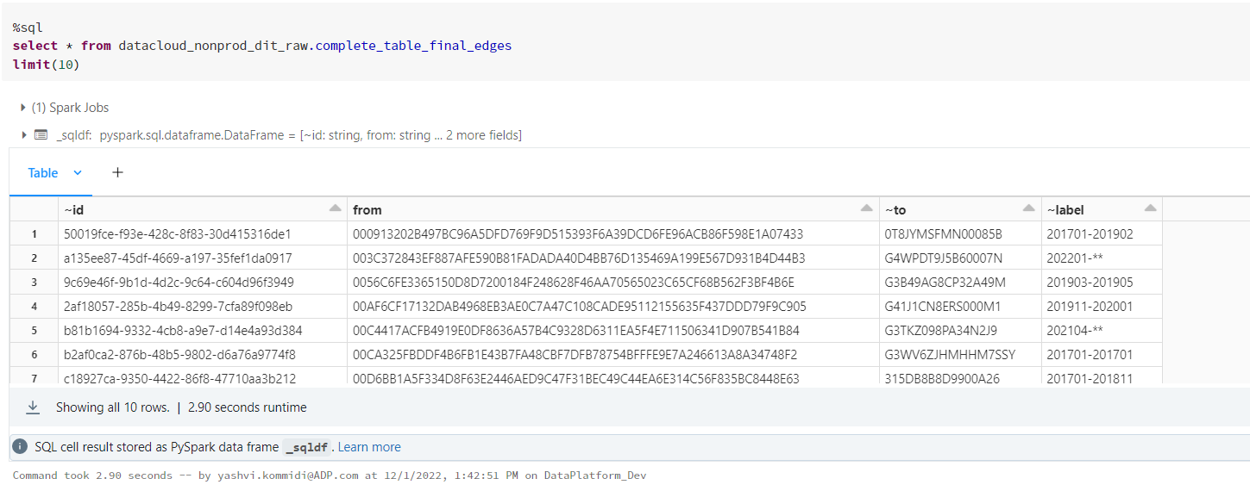

Slide 42
LOADING THE DATA INTO THE S3 BUCKET
loading vertices into s3
loading edges into s3

Slide 43
queries of data that is present in s3

Slide 44
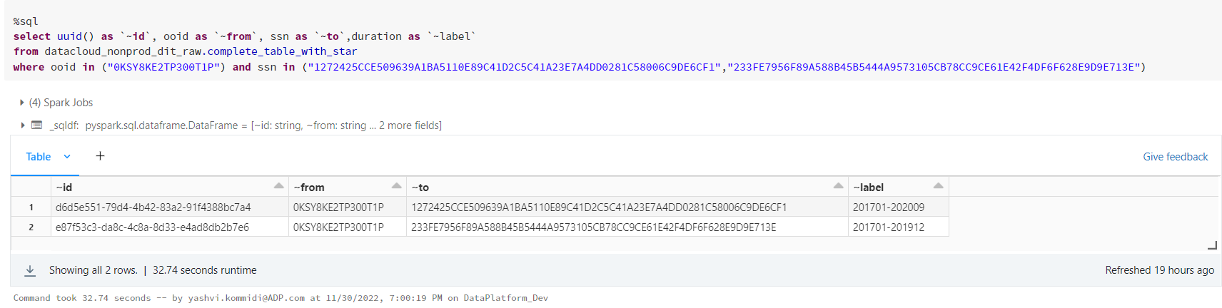

Slide 45
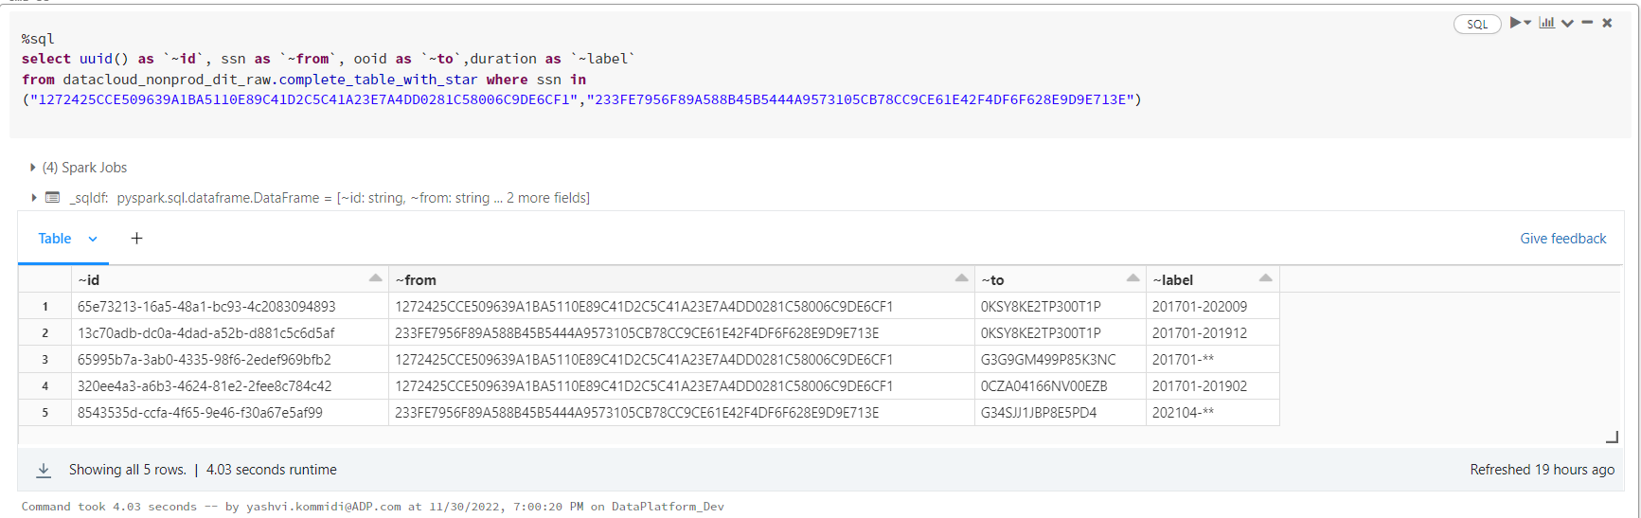

Slide 46
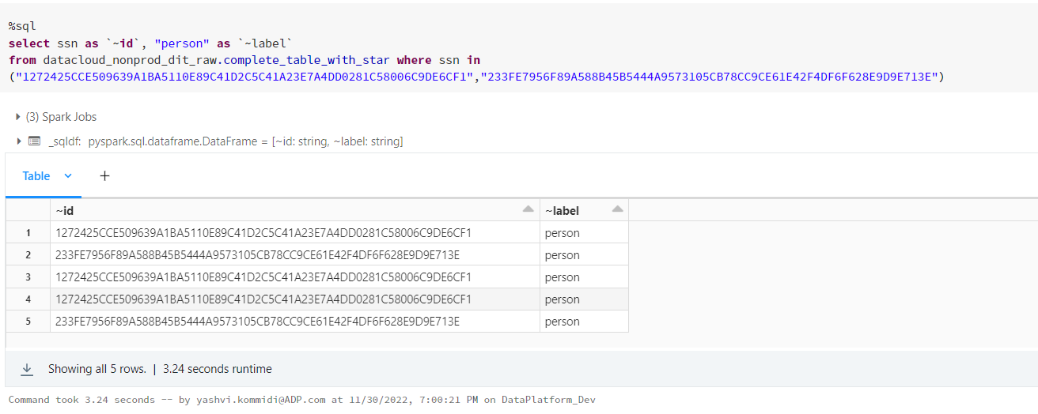

Slide 47
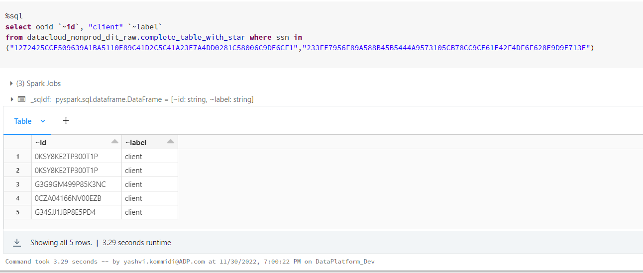

Slide 48
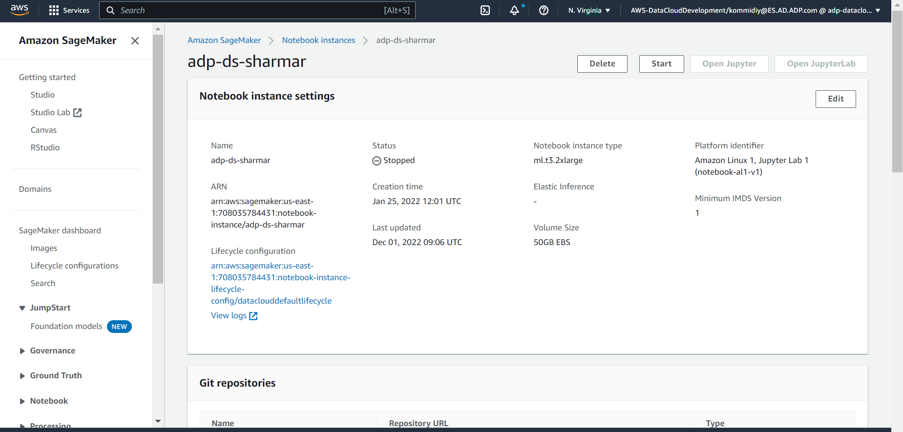

Slide 49
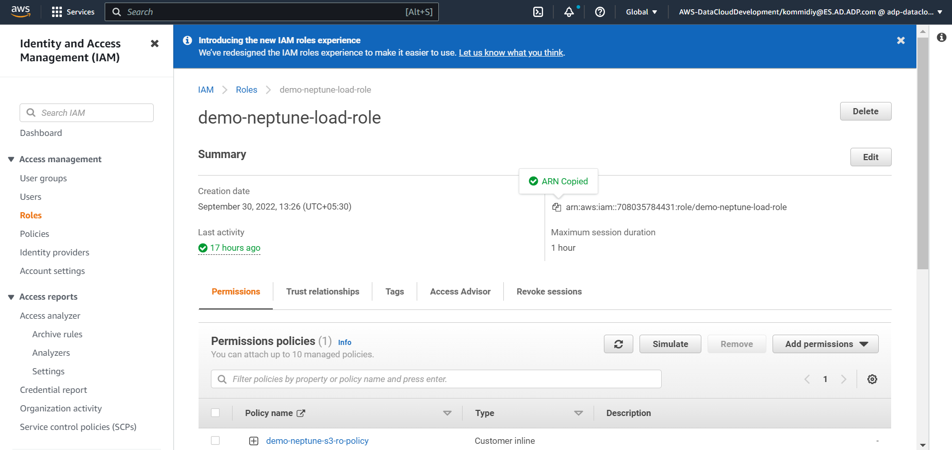

Slide 50
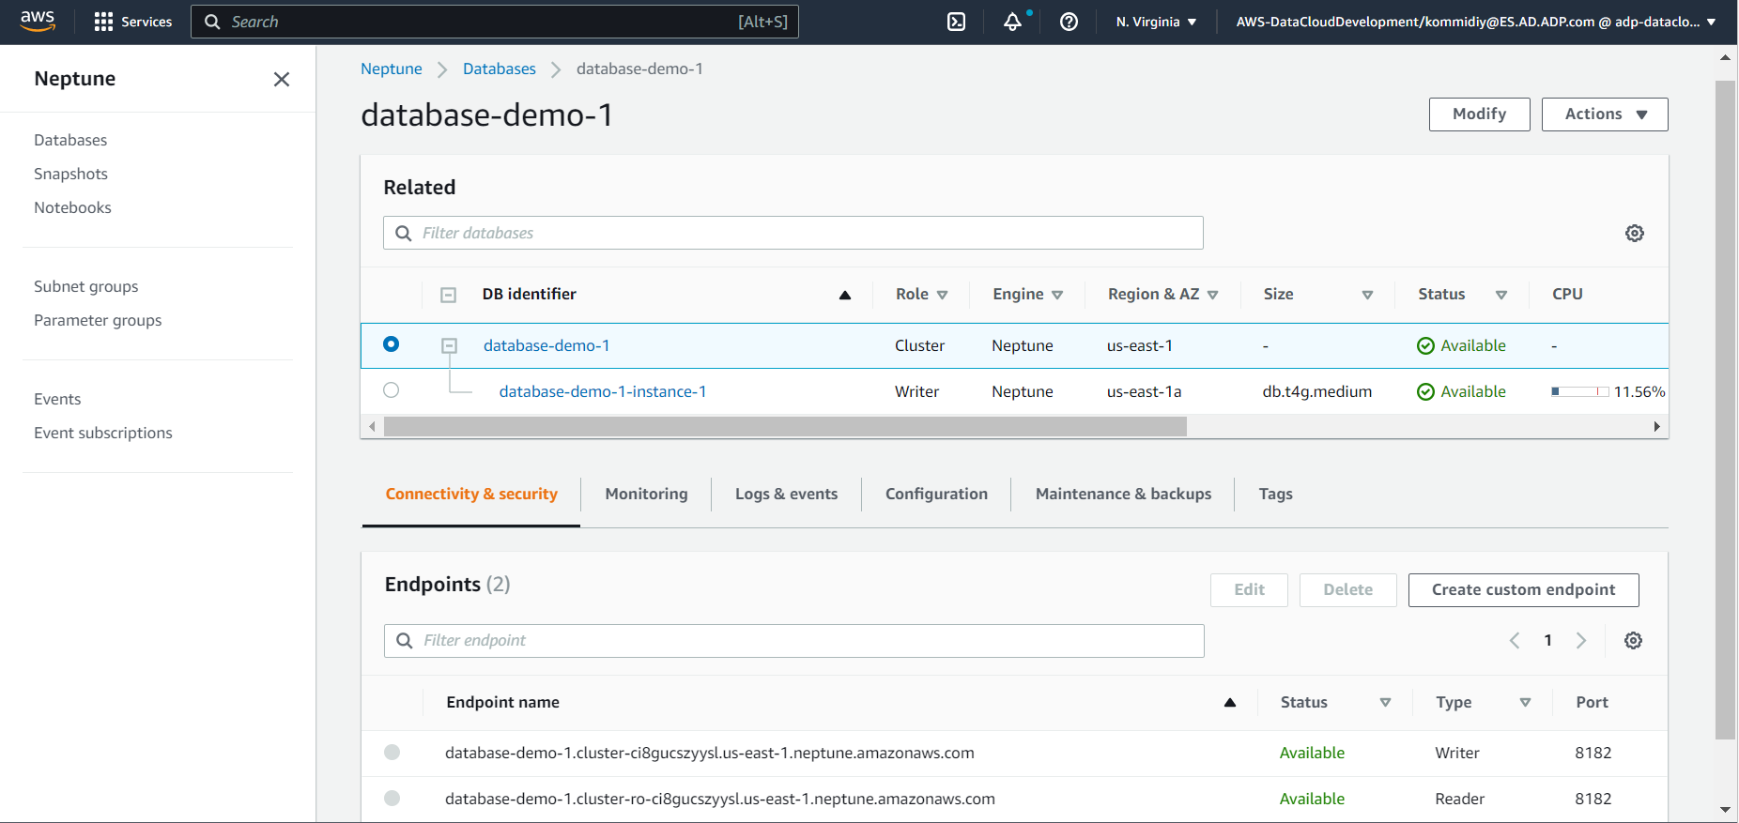

Slide 51
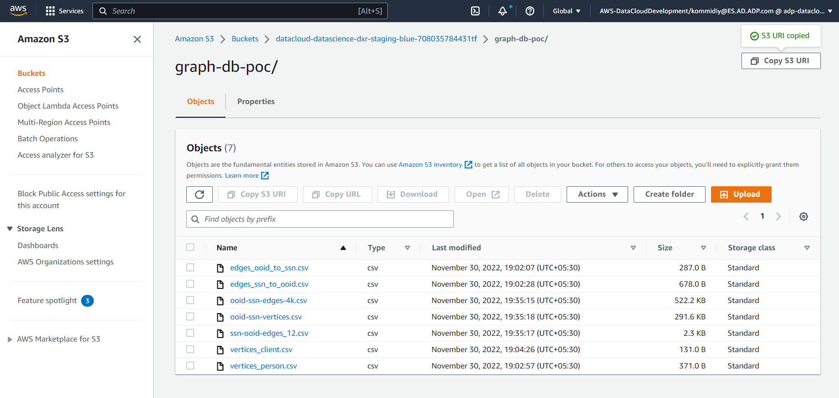

Slide 52
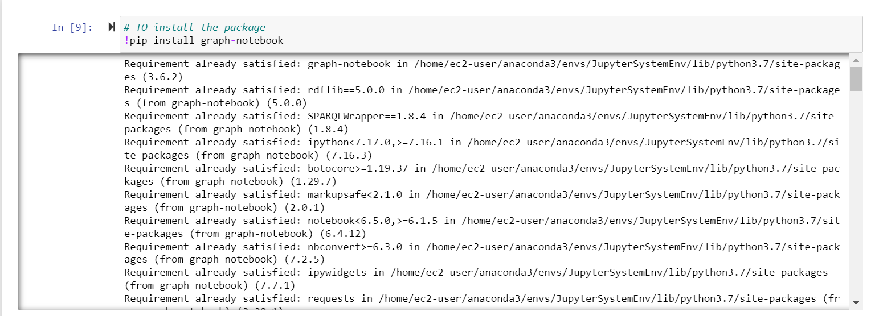

Slide 53
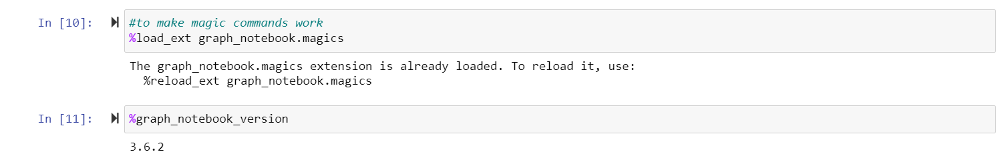

Slide 54
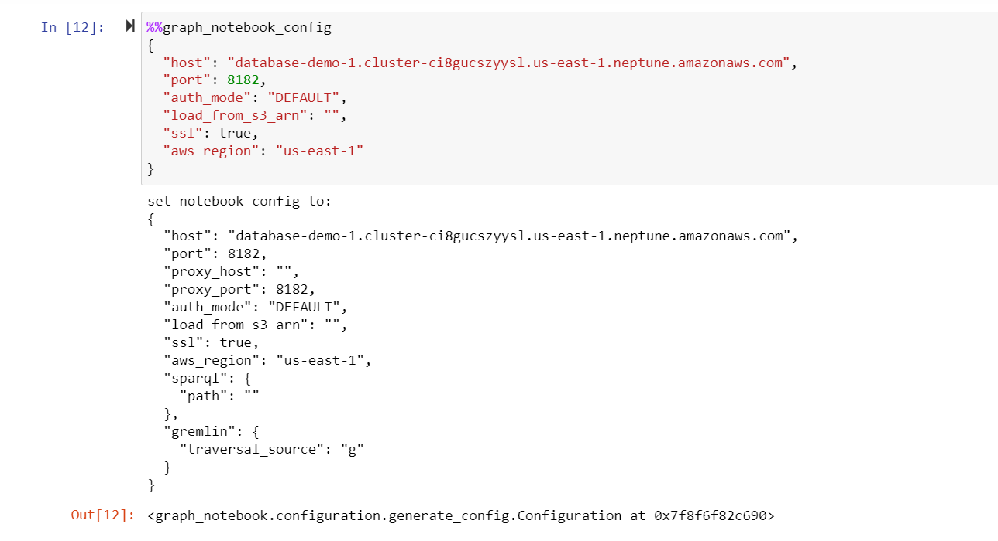

Slide 55
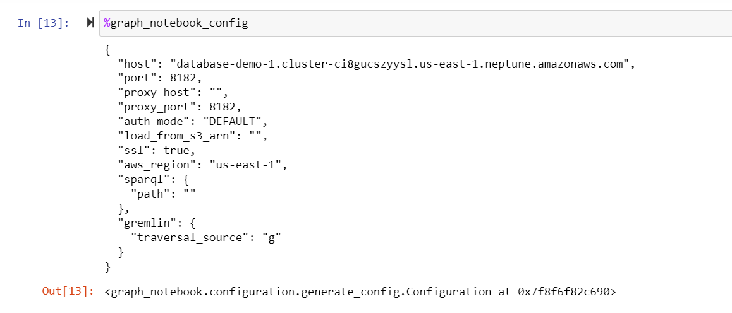

Slide 56
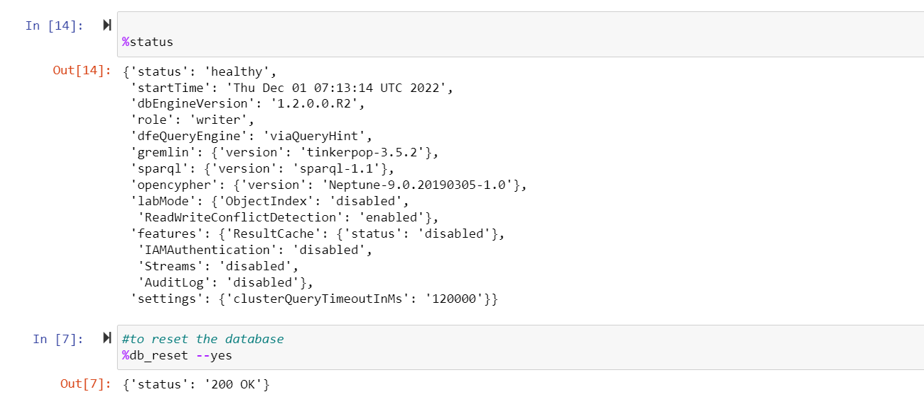

Slide 57
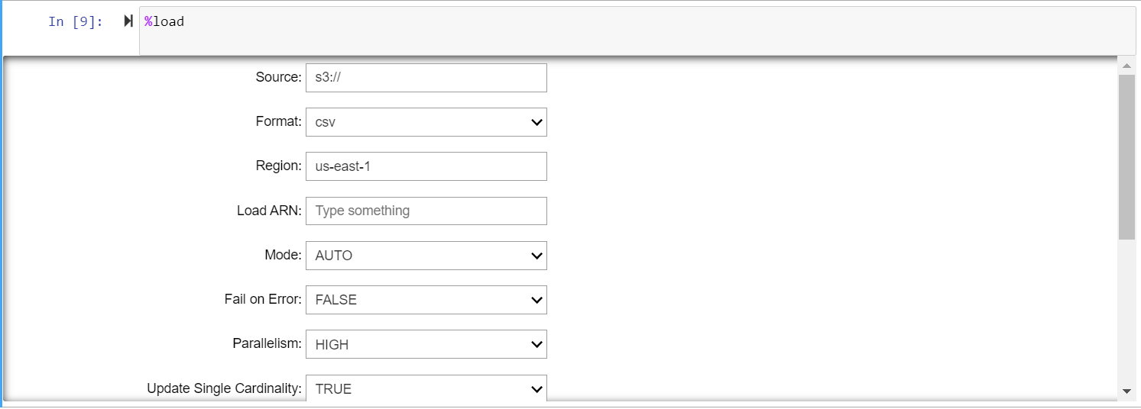
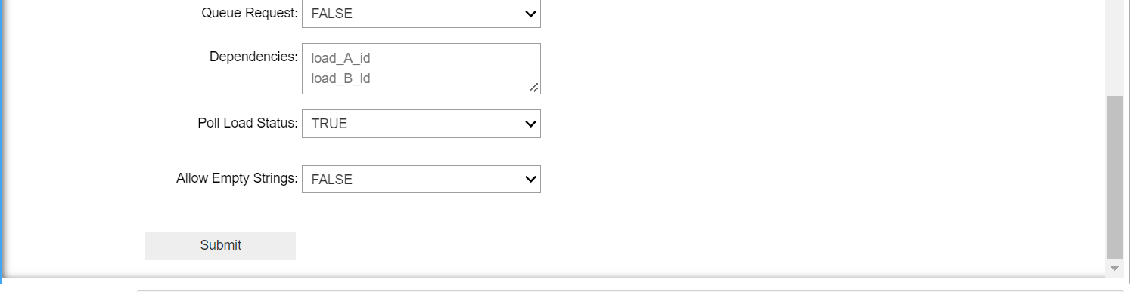

Slide 58
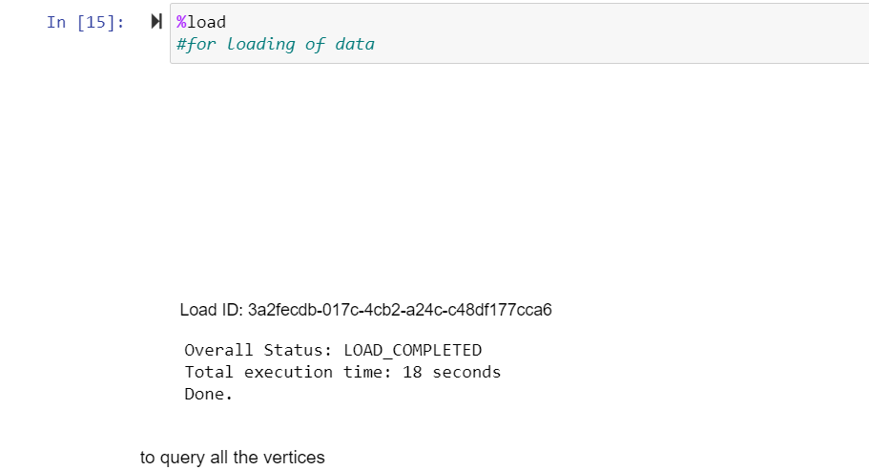

Slide 59
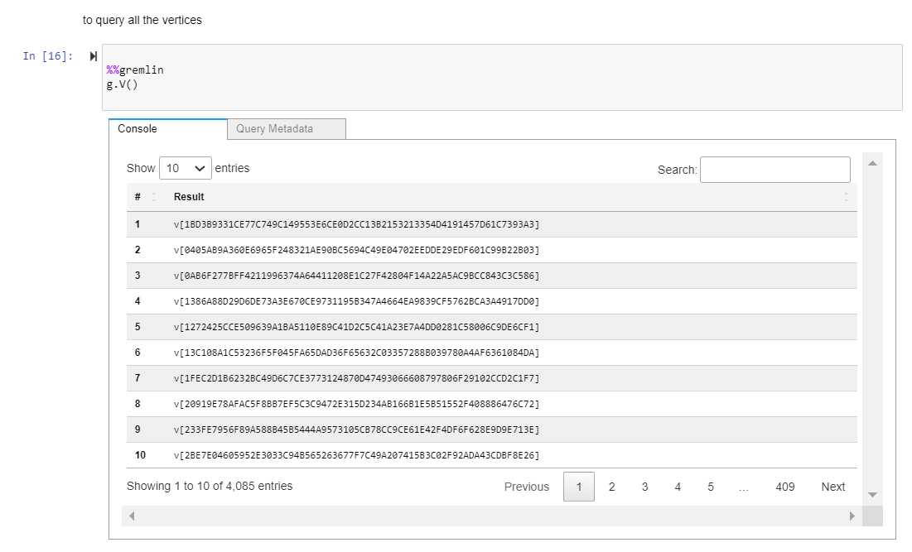

Slide 60
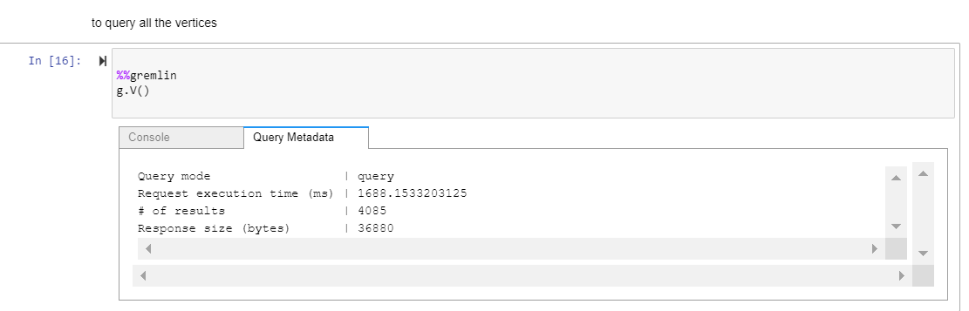

Slide 61
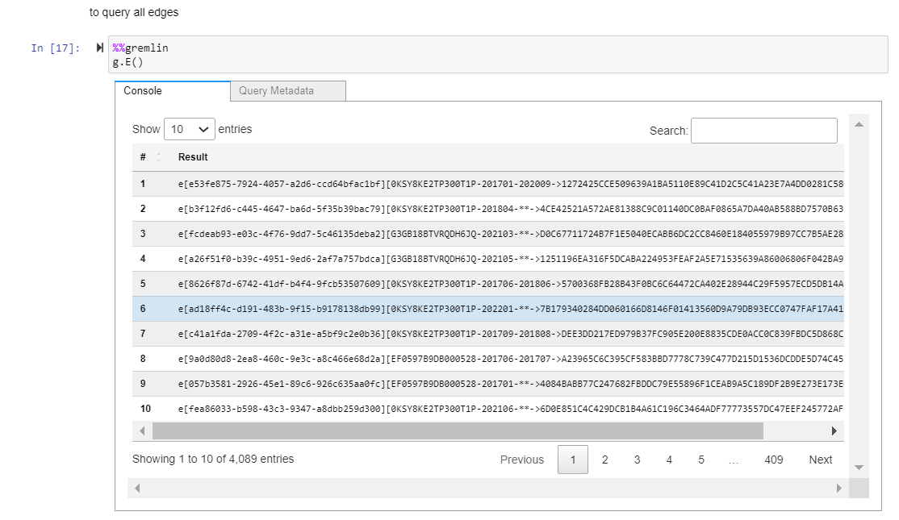

Slide 62
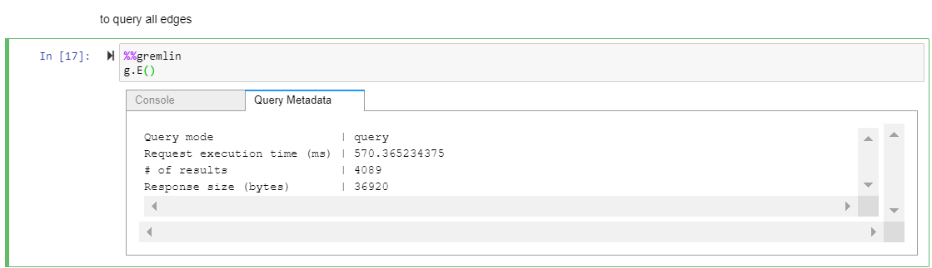

Slide 63
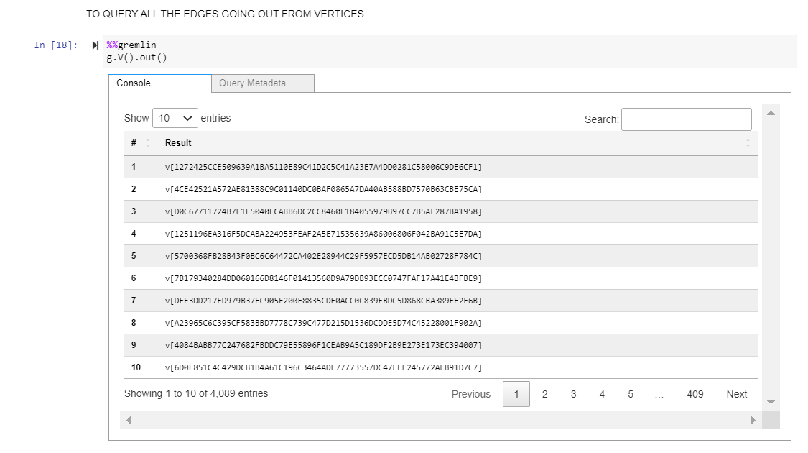

Slide 64
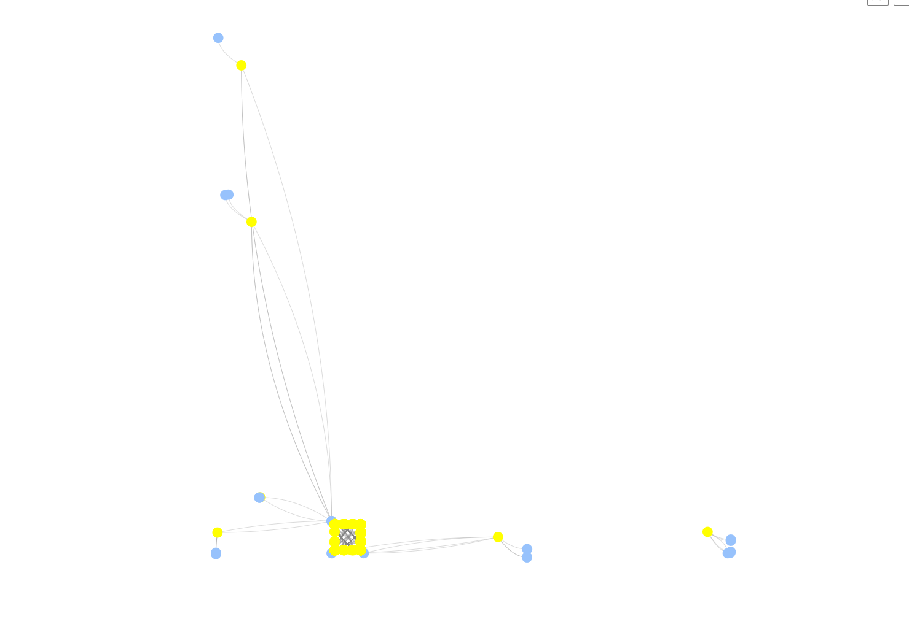
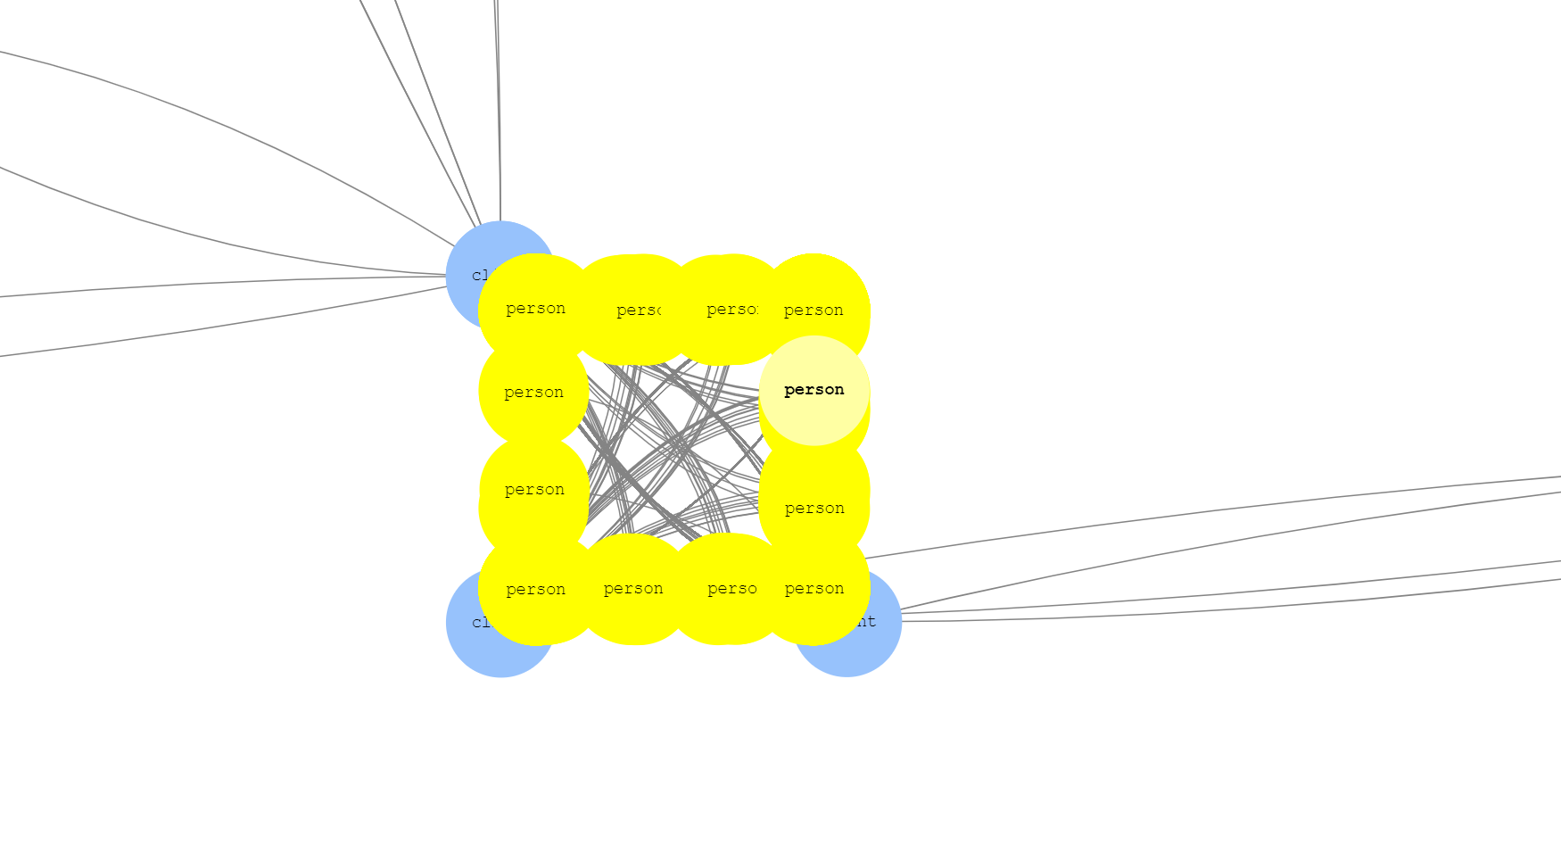

Slide 65
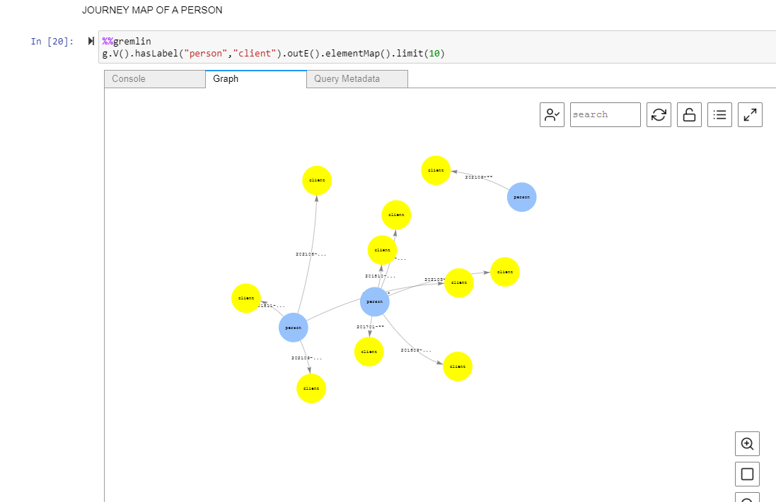

Slide 66
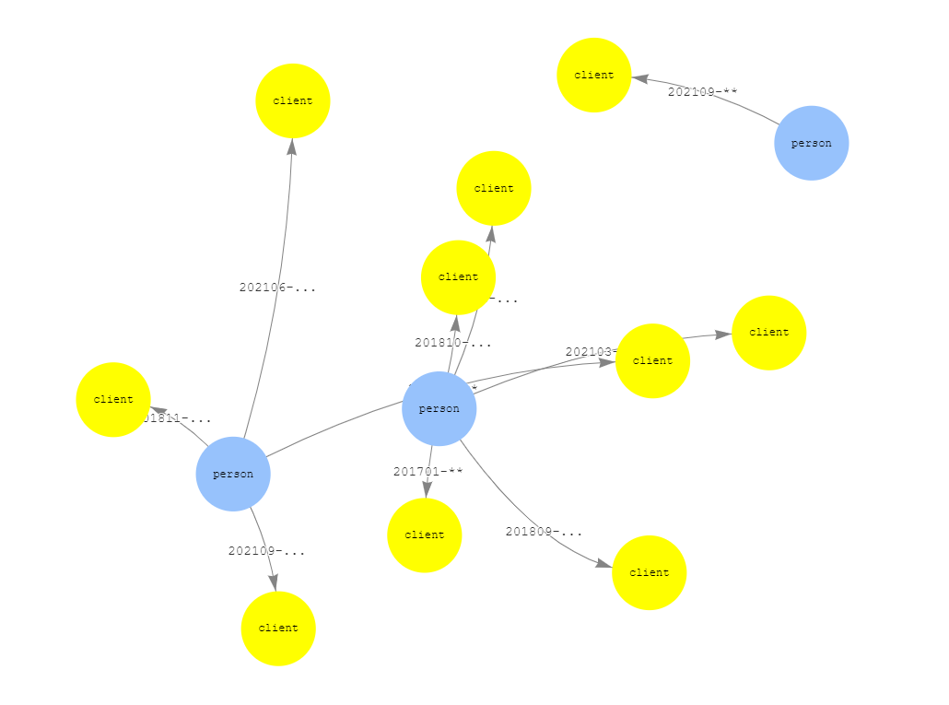

Slide 67
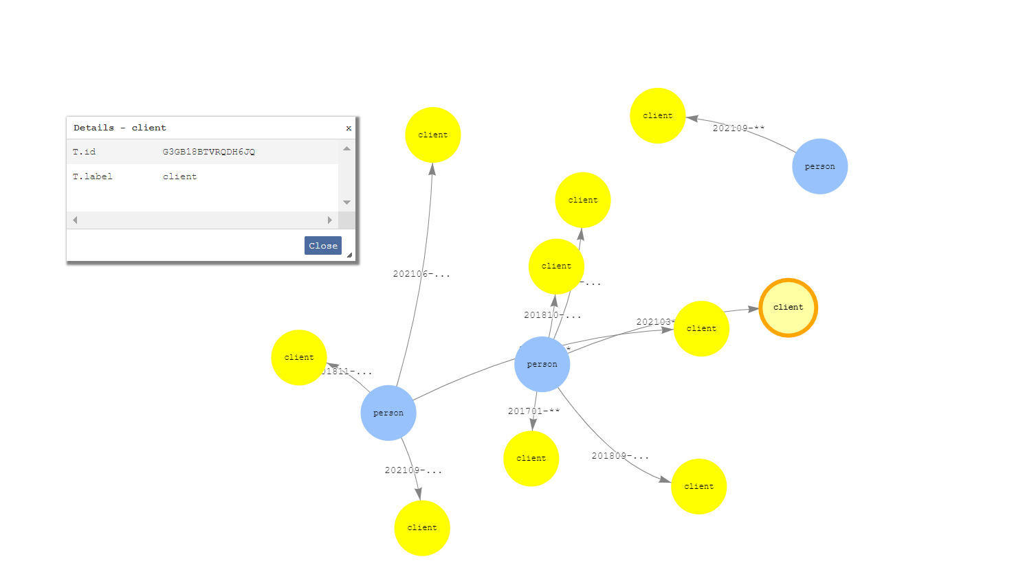

Slide 68
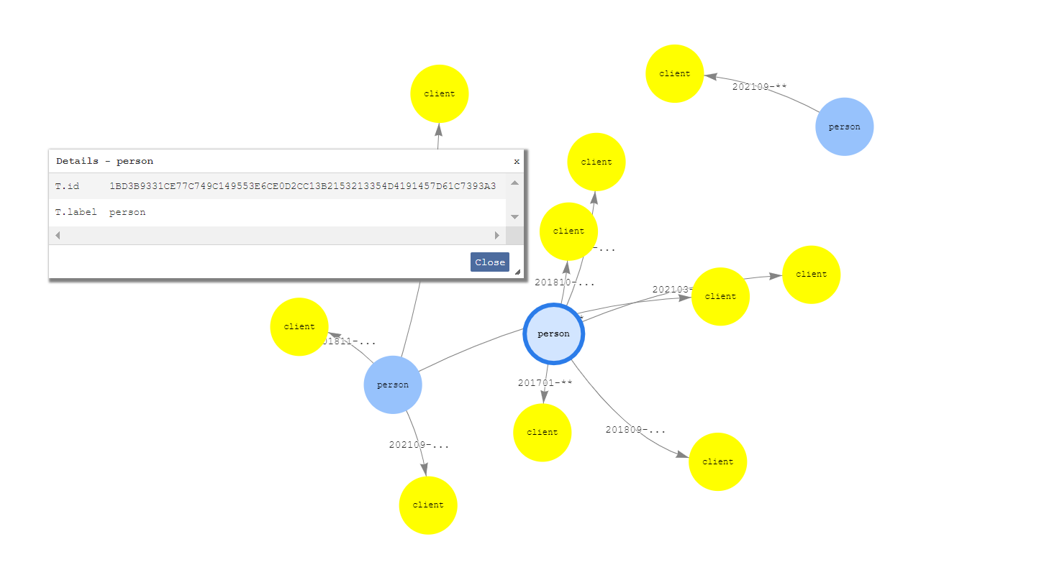

Slide 69
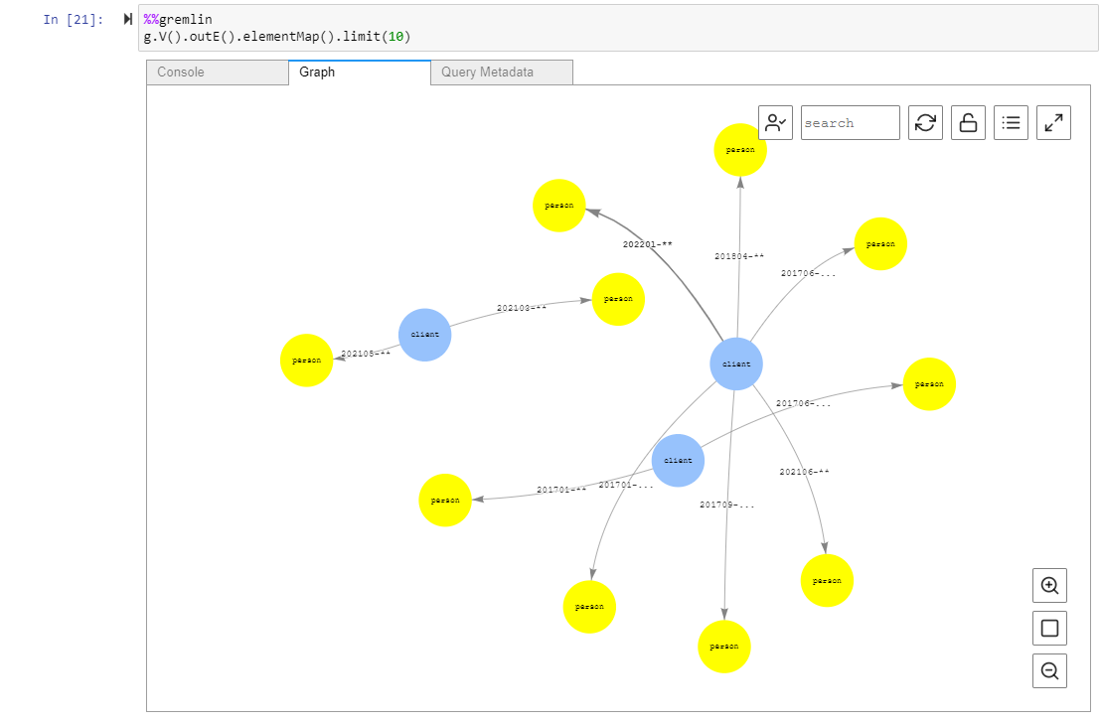

Slide 70
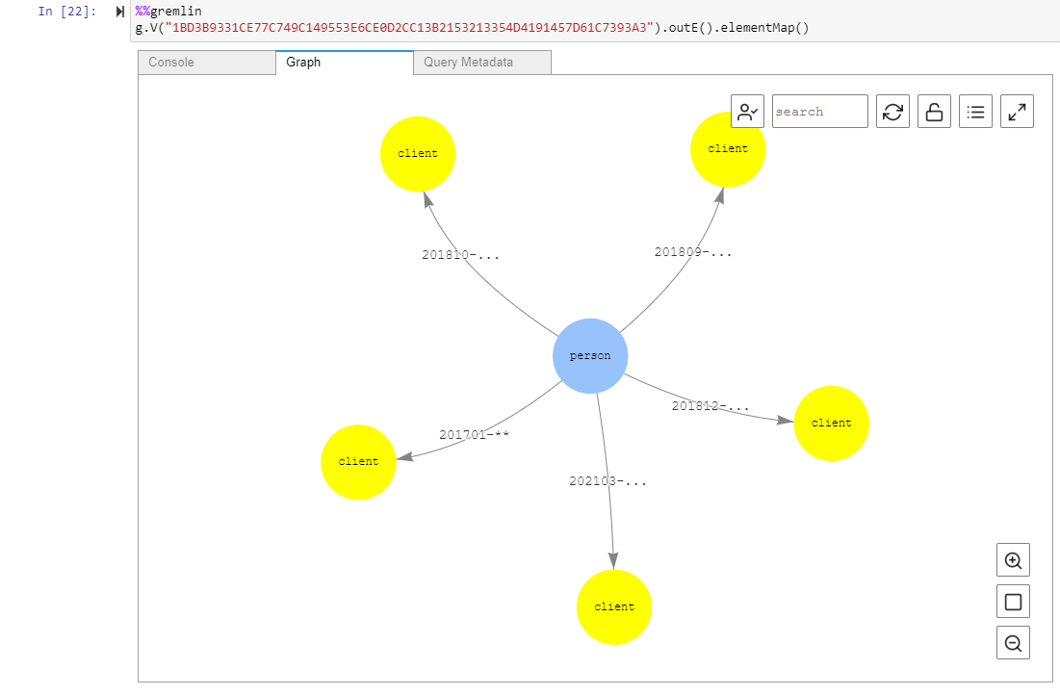

Slide 71
FOR WHICH CLIENTS, A CLIENT IS LOSING THEIR EMPLOYEES TO

Slide 72
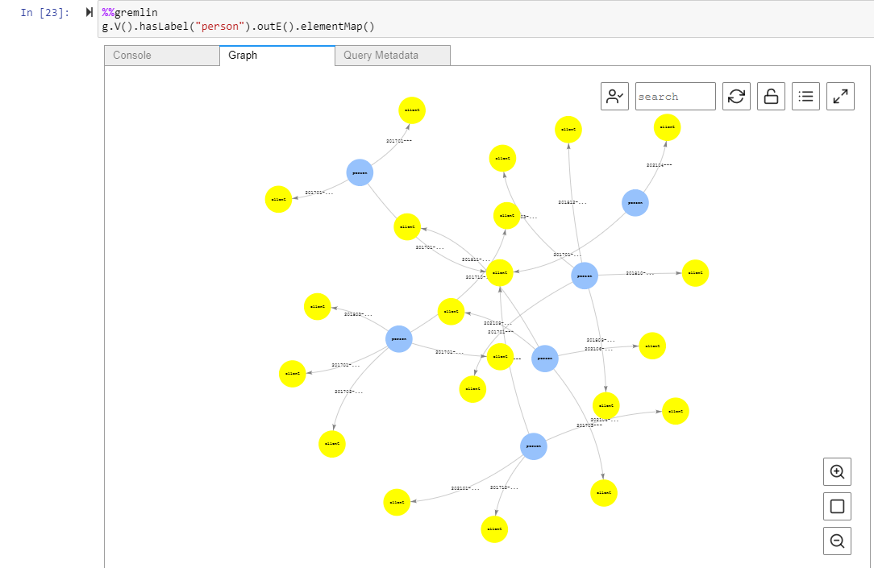

Slide 73
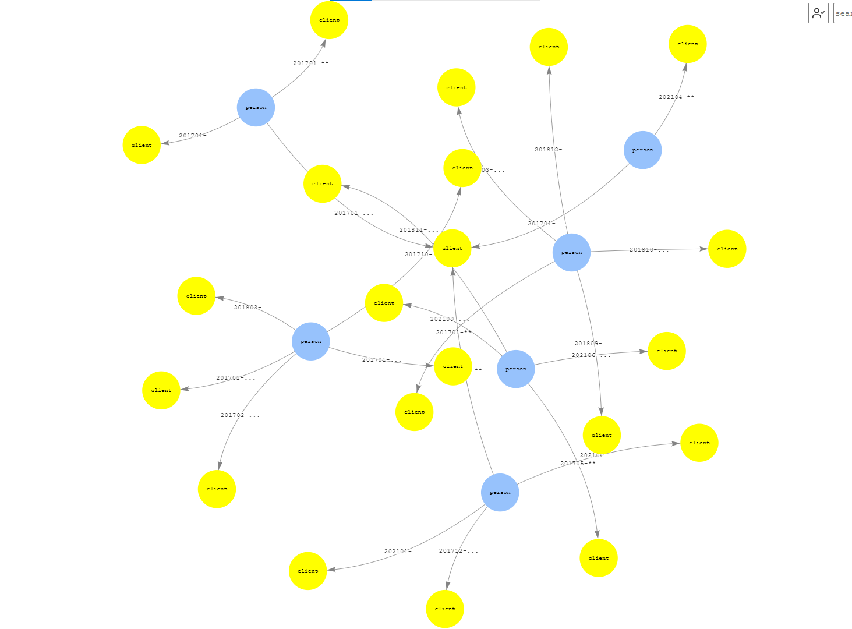

Slide 74
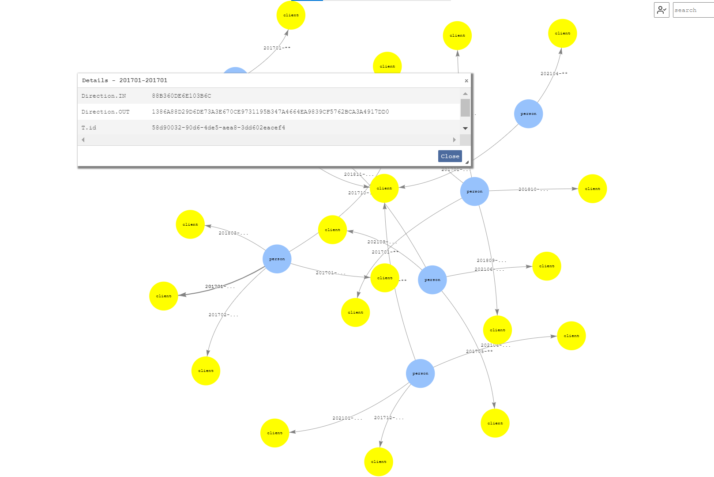

Slide 75
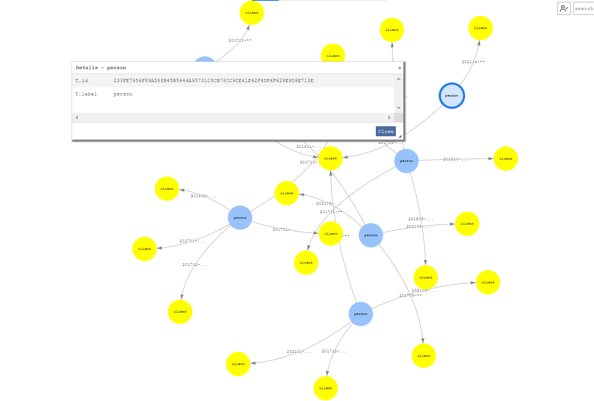

Slide 76


Slide 77


Slide 78


Slide 79


Slide 80


Slide 81


Slide 82


Slide 83


Slide 84


Slide 85


Slide 86


Slide 87


Slide 88


Slide 89


Slide 90


Slide 91


Slide 92


Slide 93


Slide 94


Slide 95


Slide 96


Slide 97


